Slide 1
Formation Control:
A Centralized and Decentralized Approach
Notes:
Brief Introduction – multi-robot formation control
Mention both centralized and decentralized implementation

Slide 2
Centralized vs Decentralized
In both cases we launch the arena as usual
Centralized: run a single controller with global knowledge
Decentralized: run a controller per robot
Each robot acts individually
A ‘leader’ robot sends messages with its state to connected robots
Other ‘followers’ update their belief of the leader and relay this message
Notes:
Both cases start by launching arena in ros the same way
Centralized approach runs a single program that acts based on global knowledge - knows every robot’s state
Decentralized approach has every robot act individually and participate in message passing to spread leader’s state - mention we pass messages on links
Knowledge of the leader is enough to get our robots back in formation with our leader-referenced scheme (explained later)

Slide 3


Formations
Line
Column
Diamond
Wedge
Notes:
Discuss how we implement formations here - one robot is the center, the others have relative positions from the center
Mention the links for message passing in decentralized solution - leader sends state (pose and sensor measurements) and followers store and relay it

Slide 4
Behavior-based control
Formation Maintenance
Goal Navigation
Static Obstacle Avoidance
Dynamic (Robot) Obstacle Avoidance
T. Balch and R. C. Arkin, Behavior-based Formation Control for Multi-robot Teams
Notes:
Paper was the basis of our work
Compute vectors for each robot for formation, goal, obstacle avoidance

Slide 5
Extending the Paper
Behavior approach was designed for open worlds
Added formation switching strategy
Robots move as a column in tight areas (corridors)
Notes:
Explain that the approach in the paper was for open worlds
Added the ability to detect corridors and tight areas using sensor measurements
Move into column formation until free again as its the narrowest formation

Slide 6
Formation Maintenance Vector
First find the desired formation position and orientation
Two methods:
Unit-Reference - Average all robot positions to find centre of formation
Requires many messages when decentralized
Leader-Reference - Leader is considered always in formation
Followers compute their vector to get in formation
Easier to implement in a decentralized system
Notes:
Explain unit-reference and why we didn’t do it - decentralized unit-reference requires global knowledge of all robot positions and lots of messages
Explain leader-reference - a leader robot is center of formation and the other followers compute a vector, formation offsets are rotated and translated onto the leader
Decentralized leader-reference is easier as only need the leader’s state

Slide 7
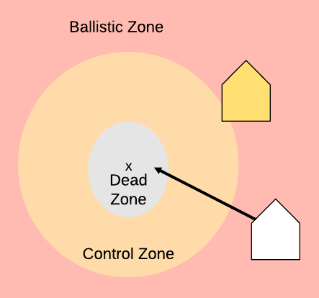
Formation Maintenance Vector
Scale vector magnitude based on distance
Dead Zone: magnitude = 0
Control Zone: magnitude scaled linearly
Ballistic Zone: magnitude = 1
Notes:
Explain the zones: dead zone = 1.5 * robot radius (1.5 * 0.0525), control zone = dead zone + spacing distance (0.3), ballistic zone outside this

Slide 8
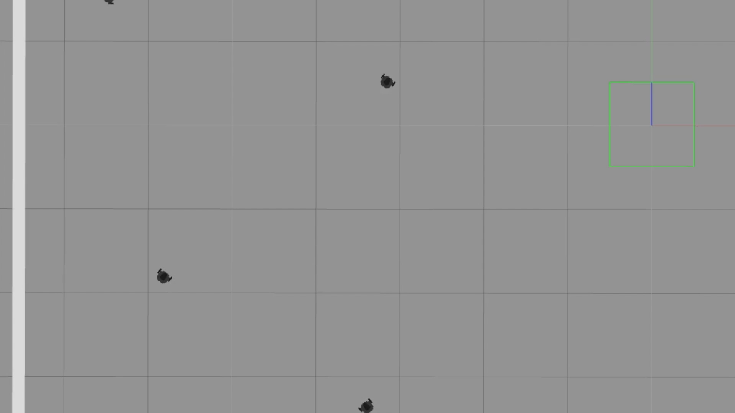
Notes:
Show robots in random places, get into formation
Robots go through each formation as they move
Undergo an orthogonal rotation

Slide 9
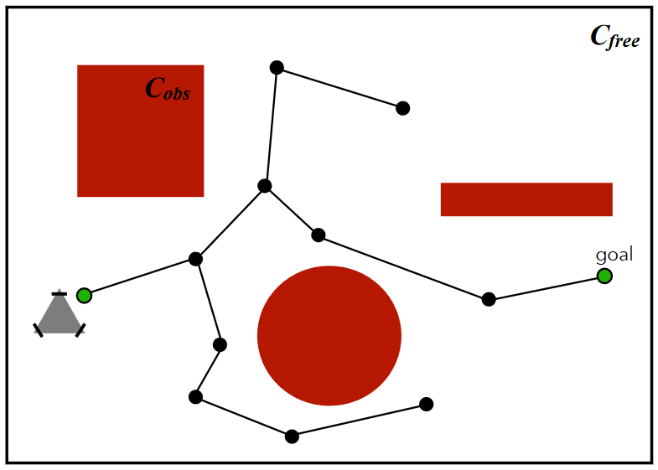
Goal Navigation Vector
The Leader computes RRT* path to some goal position
This computes a safe path for the leader only
Only the leader has a goal vector
Followers just keep formation
Notes:
Followers do not need a goal velocity
Leader runs RRT* for an obstacle free path (very briefly say we sample points, add to tree, rewire based on cost)
Mention that we can store the path to avoid computation costs in the future (makes for good evaluation argument)

Slide 10
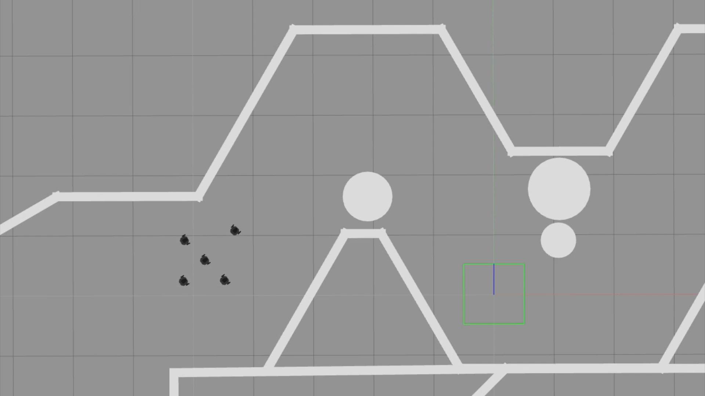
Insert video 4
Notes:
Robots navigate a path with tight corners and turns

Slide 11
Static Obstacle Avoidance Vector
Mix of Braitenberg/rule-based controllers
Robot sensors do not distinguish robots and obstacles
Leader slows down when robots are avoiding obstacles
Split and Merge
Robots pick a preferred side for moving around an object depending on their position in formation
Notes:
Mention braitenberg for centralized and rule-based for decentralized, since braitenberg is enhanced to account for all robot positions
SAY RULE BASED ONLY on each robot for decentralized
Can say lasers are poor against other robots in practice
Robots have the formation velocities switched for goal velocities sometimes, so they can move in the right direction without falling into an obstacle, keeps it robust.

Slide 12
Dynamic (Robot) Obstacle Avoidance Vector
Compute an ‘on-off’ vector that stops moving a robot when:
They get close
They face each other
O(n²) as we consider robots in pairs, stop the one with lowest ID, to prevent deadlock
Notes:
Explain robot avoidance weights as stopping a robot from moving, includes how in-front of each other they are, and is efficient

Slide 13
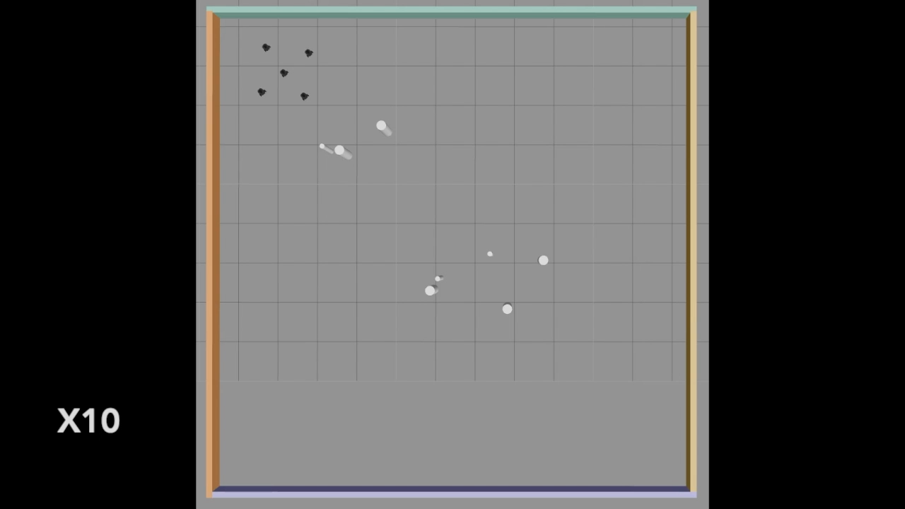
Insert video 2
Notes:
Robots split and merge around obstacles
Split around obstacles and merge back into formation

Slide 14
Weighted Combination
Overall velocity vector computed as a weighted sum of goal, formation, obstacle avoidance and noise vectors
Apply ‘rules’ to filter spurious/erroneous velocities:
Robots stop if they are about to collide with another robot
Robots stop at the goal
Leader can slow down if followers not in formation
Notes:
Explain how weights affect the relative contribution and behavior, leading to split-and-merge, with 5% noise to avoid minima
Mention our weights (.35 goal, .2 formation, .22 obstacles)
Mention how robot avoidance weights are used, how we stop spurious movement if at goal, and how we slow the leader so others can catch up (scale by .3)

Slide 15
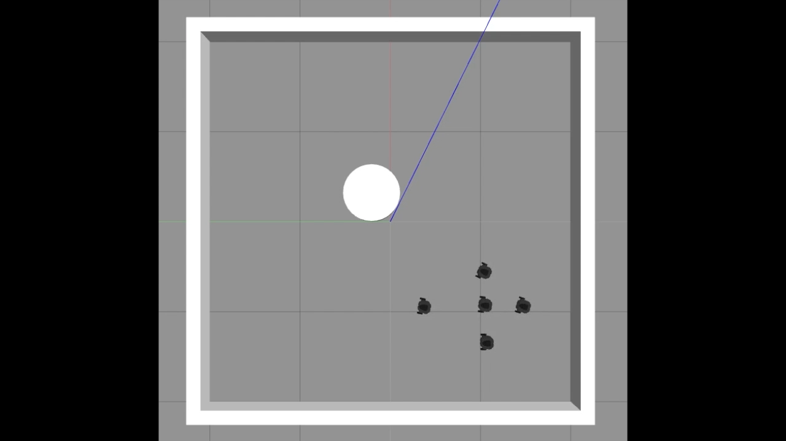
Insert video 3
Notes:
Robots navigate to goal and split and merge around obstacle and into formation
Achieved with weighting obstacle avoidance higher than formation to get the split

Slide 16


Formation Switching
Use robot sensors to detect tight gaps
Centralized: Switch formation if leader (or majority of robots) detect a tight gap
Decentralized: Only the leader sensors are used
Formation becomes a column
Notes:
Explain the use of robot sensors to detect enclosed space on the sides to determine a corridor (within .8 on the sides with a large front (>1.))
Mention the switching condition - leader detects tight area or half of followers do, which prevents switching back formation until half of the robots are out of the corridor
Decentralized case only based on leader’s detection

Slide 17
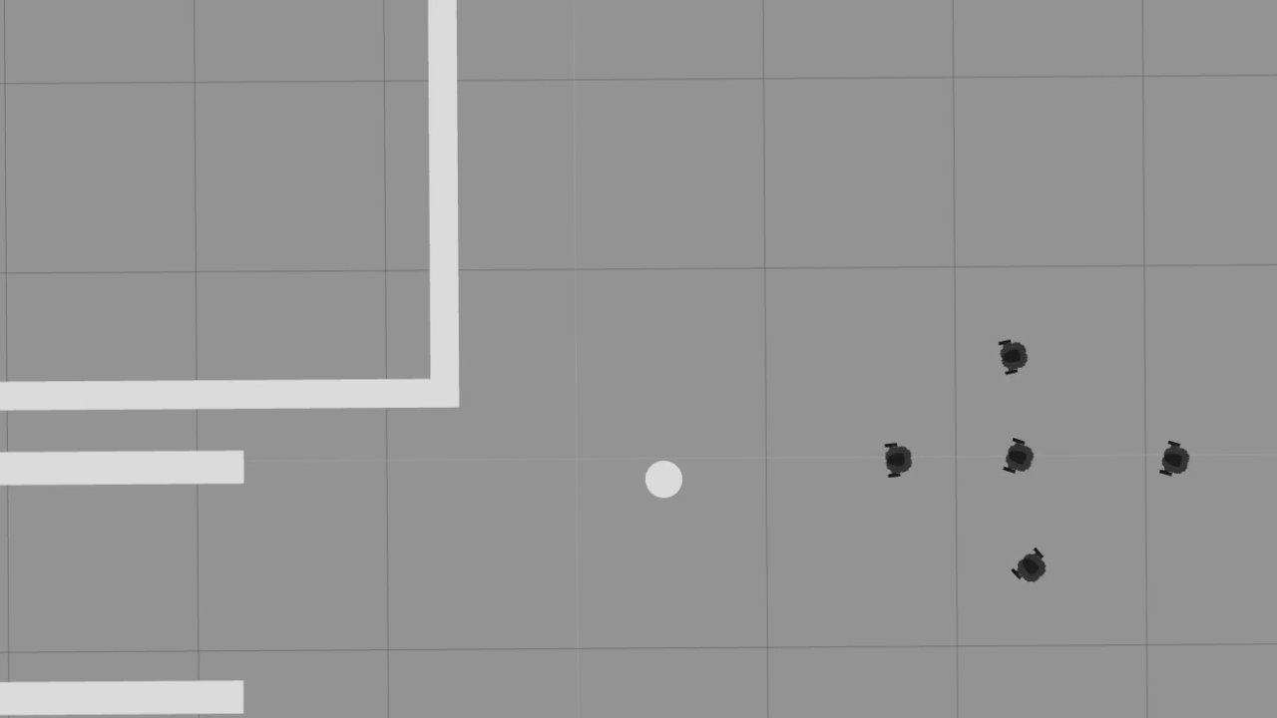
Insert video 6
Notes:
Video shows everything
Split and merge, formation switching to column (safety formation), a tight corner, and a new obstacle (it’s adaptive)

Slide 18
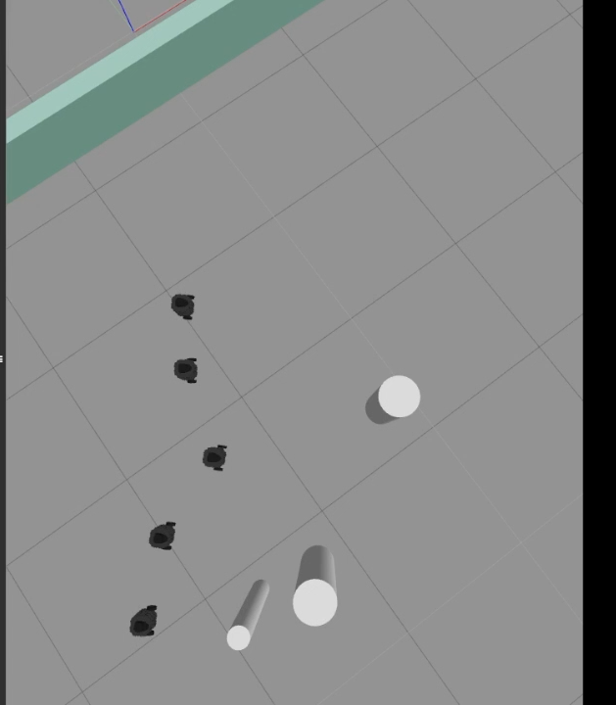
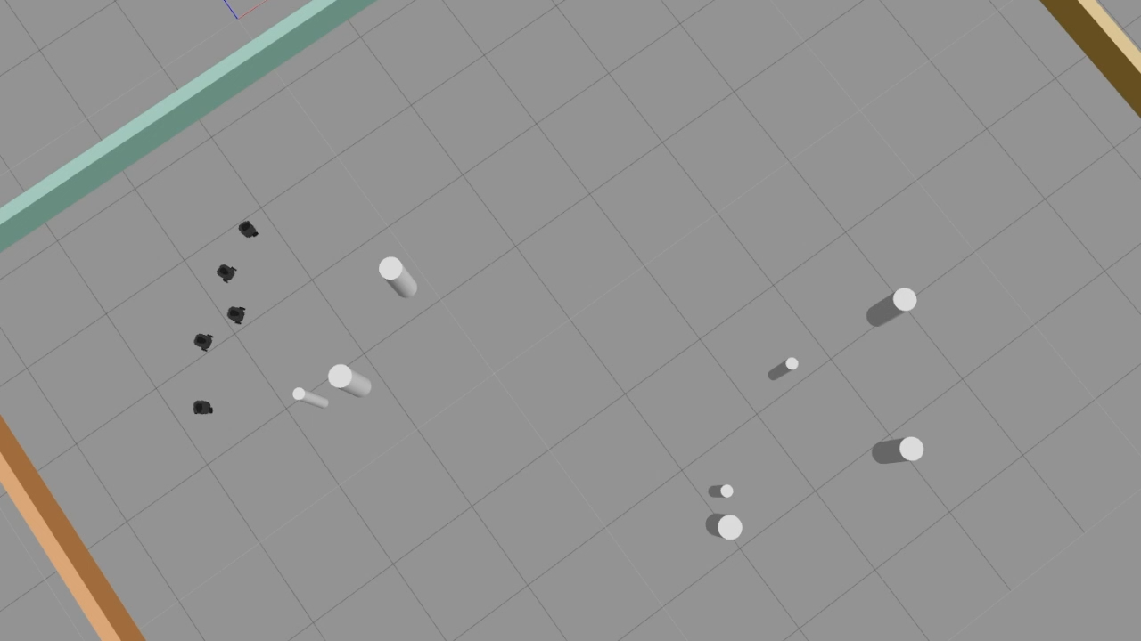
Centralized vs Decentralized Example
Centralized
Decentralized
Notes:
Videos show centralized and decentralized examples side-by-side

Slide 19
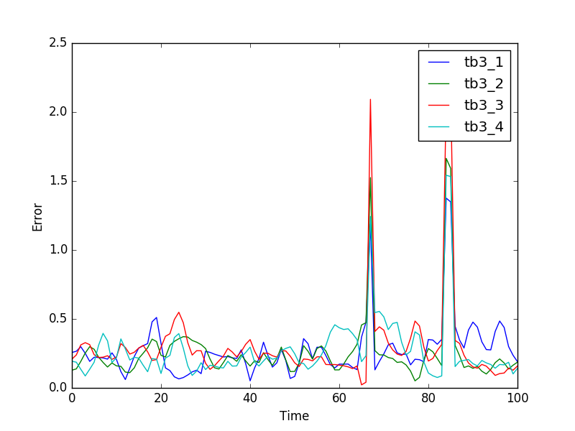
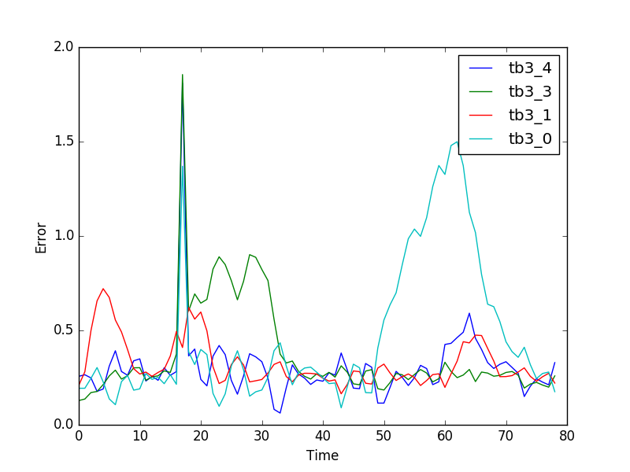
Results
Accuracy
Error plot of distance to target with 5% noise
Centralized
Decentralized
Notes:
Talk about accuracy as the error to the target position
Added 5% noise to velocity - simulates erroneous readings in position and sensors as well as handling minima
Centralized solution only has major spike during second set of denser obstacles but still looks nice, decentralized clearly less robust yet still functional

Slide 20
Results
Robustness - Our general approach isn’t perfect
Centralized obstacle avoidance is improved with global knowledge
Decentralized solution not to the same level with just knowledge of leader
Efficiency - RRT* can take a long time so we precompute paths
Notes:
Talk about robustness and some cases being sub-ideal due to obstacle avoidance - maybe reference motion in a video
RRT* can take on the order of minutes which is not ideal, storing precomputed paths is nice

Slide 21
Results
Future Work
Try cheaper straight-line goal velocities, rely on obstacle avoidance
Improve obstacle avoidance to improve robustness in the general case
Consider reinforcement learning to adjust weights for each environment
Decentralized approach - communicate more state from each robot
Notes:
Cheaper goal velocities and rely on obstacle avoidance velocities
Better obstacle avoidance to reduce error
Improve decentralized approach that stores the state of every robot, can then apply robot avoidance weights and better obstacle avoidance

Slide 22
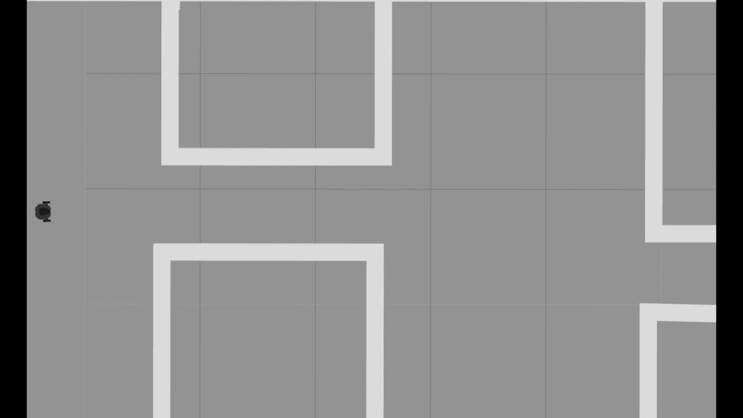
Link to code repository - github.com/DoodleBobBuffPants/RobotProject
Notes:
Formation switching and navigation with tight corridors and multiple formations
Concluding remarks - can perform formation-based movement, but general robustness isn’t easy, and it’s easily decentralized
Mention where the code can be found

